Slide 1
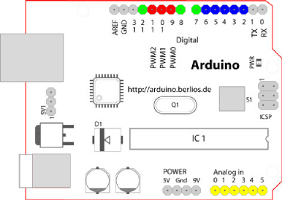
Car Controller Module
1. Arduino Pin
Pin #2 : Unlock Switch for door
(Input) (5V-->5V)
Pin #3 : Lock Switch for door
(Input) (5V-->5V)
Pin #4 : Ignition_check
(Input) (12V-->5V)
Pin #5 : Door_Statue
(Input) (12V-->5V)
Pin #6 : Alarm Trigger
(Input) (5V-->5V)
Pin #7 : Ignition_check
(Output) (5V-->5V)
Pin #8 : Door_Statue
(Output) (5V-->5V)
Pin #10: Horn
(Output) (5V-->12V)
Pin #11: Light
(Output) (5V-->12V)
Pin #12: Door Lock
(Output) (5V-->12V)
Pin #13: Door Unlock
(Output) (5V-->12V)
Figure 1. Arduino Duemilanove

Slide 2
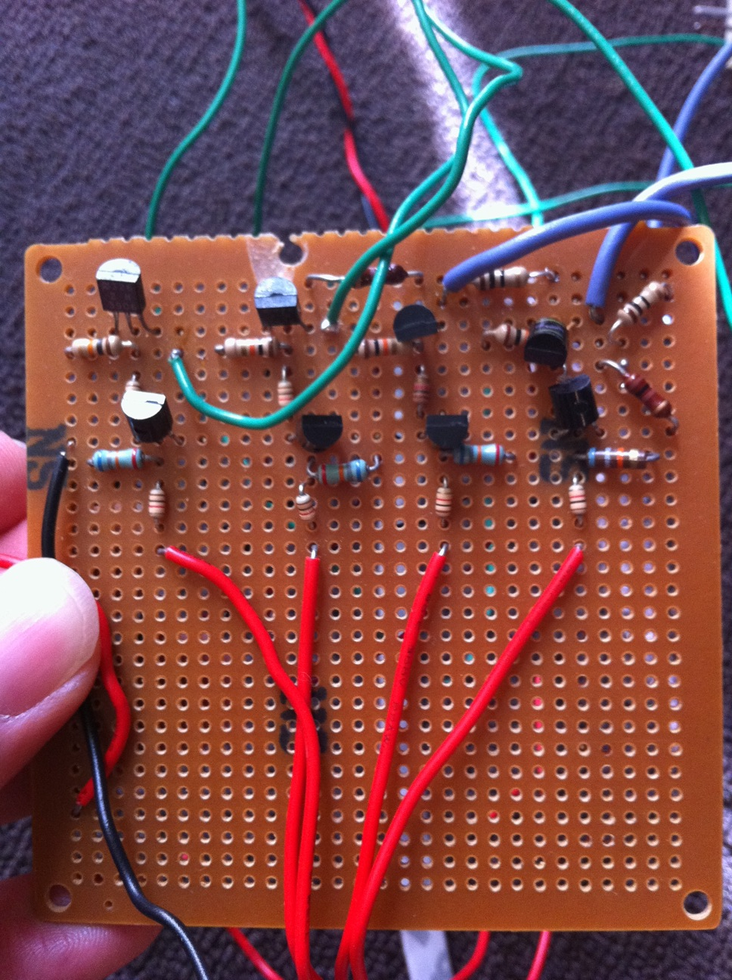
Car Controller Module
2. 5V to 12V NPN & PNP Amplifier
Figure 2. BJT AMP Module

Slide 3

Car Controller Module
3. Door Lock/Unlcok Demonstration
Figure 3. Door Lock/Unlock Module

Slide 4
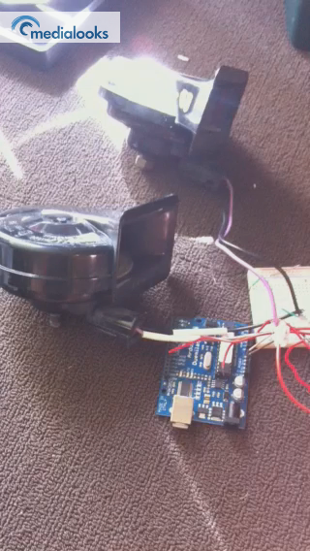
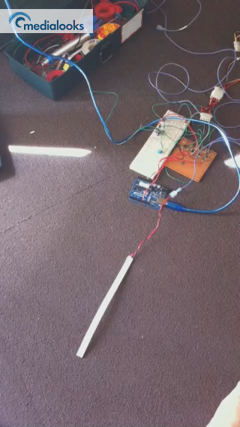
Car Controller Module
4. LED, and Horn Demonstration
Figure 4. LED Demonstration
Figure 5. Horn Demonstration

Slide 5
Car Controller Module
5. To do
Horn controller
Door Statue Module
X-bee

